Slide 1


0

Slide 2
MEANING
TEAM: Team is simply another group.
TEAMWORK: Teamwork is work done with an understanding and commitment to group goals on the part of all team members.

Slide 3
DIFFERENCE
SOLO LEADER
TEAM LEADER
Plays unlimited role.
Strives for conformity.
Collects acolytes.
Project objectives.
Chooses to limit role.
Builds on diversity.
Seeks talent.
Develops colleagues
Creates mission.

Slide 4
LEADER ACTIONS THAT FOSTER TEAMWORK
ACTIONS LEADERS CAN TAKE USING THEIR OWN RESOURCE
DEFINING THE TEAM’S MISSION:
The mission statement for the group helps answers the questions, “Why are we doing this?”
A leader can specify the mission of the organisation when the teams are formed.
Being committed to the mission improves teamwork.

Slide 5
2.ESTABLISHING A CLIMATE OF TRUST
Unless team has trust on each other they cannot depend on each other and hence will not be able to form the team.
Encouraging open communication about problems and sharing information are two specific ways the leader can promote a climate of trust.

Slide 6

3. DEVELOPING A NORM OF TEAMWORK, INCLUDING EMOTIONAL INTELLEGENCE
To develop teamwork its necessary to promote the attitude among group members that working together effectively is expected.
Nokia Inc. based in Finland, illustrates team work type of organisational culture.
Part of culture of collegiality can be traced to Finnish character.

Slide 7


4. Emphasizing pride in being outstanding
A standard way to build team spirit, should be to realise why it should be proud of its accomplishments.
If a group is good at some task, leader can make the team identify that task or characteristic and promote its key strength.
For Ex: the shipping deptt might have the best on-time shipping record in the region.

Slide 8
5. Serving as a model of teamwork, Including Power Sharing
Interacting extensively with team members serves as a model of teamwork .
While interacting with the team members, team leader can emphasis that you are a team member.
REPLACE ‘I’ WITH ‘WE’.
For ex: He/she might say, “Remember the deadline. We must all have the proposal in the mail by Thursday.
OR
“Remember the deadline. I need the proposal in mail by Thursday.”

Slide 9
6. Using consensus Leadership style
Teamwork is enhanced when a leader practices consensus decision making.
When team members get a chance to contribute in important decisions, they feel that they are valuable part of team.
Team leader must make sure that all the members are heard.

Slide 10
7.Establishing urgency, demanding performance standards, and providing direction
To establish urgency, the leader must challenge the group regularly.
“To achieve the best department award we need to introduce new techniques of services.”
As a result team is going to focus on a common purpose, set clear goals, and work together smoothly.

Slide 11
8. Encouraging competition with other group
When encouraging competition with another group, leader should encourage rivalry, not intense competition which may lead to unethical business practices, such as making false charges against each other.

Slide 12
9. Encouraging the use of Jargon
Jargons in an organisation create bond among team members.
Microsoft labels the intelligent person as “bandwidth” and a serious person as “hardcore”.

Slide 13
10.Minimising micromanagement
Micromanagement is close monitoring of most aspects of group member activities.
To be a good leader, a manager must give ample opportunity to manage their own activities.
It does not mean that leader will not give the instructions and guidance. But he must let the team decide how the things should be.

Slide 14
11. Practicing E-leadership
In an organisation today, internet influences the leader’s work to some extent.
If a team leader in London sends a note of congratulations to Sunita in Mumbai, through the mail, he’s practising e- leadership.
E-Leadership is a form of leadership practiced in a context where work is mediated by information technology.

Slide 15
ACTIONS GENERALLY REQUIRING ORGANISATION STRUCTURE OR POLICY
1. DESIGNING PHYSICAL STRUCTURES THAT FACILITATE COMMUNICATION:
Team work is fostered when team members are located close together and interact frequently and easily.
In contrast people who spent most of their time in office or cubical are less likely to interact.
Frequent interaction often leads to feeling of belongingness.
A useful tactic for achieving physical proximity is to establish a shared physical facility, such as a conference room, research library, or beverage lounge.
These rooms can be used for refreshments and group interactions.

Slide 16
2. Emphasing group recognition and reward
Recognition accompanying the reward should emphasize the team’s value to organisation rather than that of the individual.
Recognition promotes team identity by enabling the team to take pride in its contributions and progress.
Recognition can be in the form team performance pay for skill, gain sharing(Bonus), and profit sharing.

Slide 17
3. Initiating Ritual and ceremony
Ritual and ceremony afford opportunities for reinforcing values, revitalizing spirit and bonding workers to one another and to the team.
Example: Holding a team dinner whenever the group achieve a major milestone.
Party at employees home.
New session Puja.
Birthday, Wedding and newly wed Parties.

Slide 18
4. Practicing Open-Book Management
In open book management, every employee is trained, empowered and motivated to understand and pursue the company’s business goal.
In this way employees become business partners and perceive themselves to be members of the same team.
In a full form of open management workers share strategic and financial information as well as responsibility.
The idea is to have a well informed, partner oriented, high performance company.

Slide 19
5. Selecting Team-Oriented members
Selecting people who are interested in and capable of teamwork.
A starting point is self selection.
Many managers believe that who participate in team sports now or in the past are likely to be good players on the job.
HOW?

Slide 20
6. Using technology that enhances teamwork
Workers can collaborate better when they use information technology that foster collaboration, often referred to as groupware.
Exchanging frequent email messages can facilitate cooperation.
Use of websites for information.

Slide 21
7. Developing a Team Book
Team book contains one page biography of each team member with one photo, interests, hobbies and family information.
It may also contain a page where the team members make comment on the person.
As the group member will flip through the book, they become better acquainted with the coworkers.

Slide 22
LEADER-MEMBER-EXCHANGE MODEL AND TEAM WORK
LMX is developed by George Graen and associates.
Helps explain why one subgroup in a unit is part of a cohesive team but another group is excluded.
One subset of employees, the IN-GROUP is given additional rewards, responsibility and trust in exchange for loyalty and performance.
In contrast, the OUT-GROUP employees are treated in accordance with a more formal understanding of leader-group member relations.

Slide 23
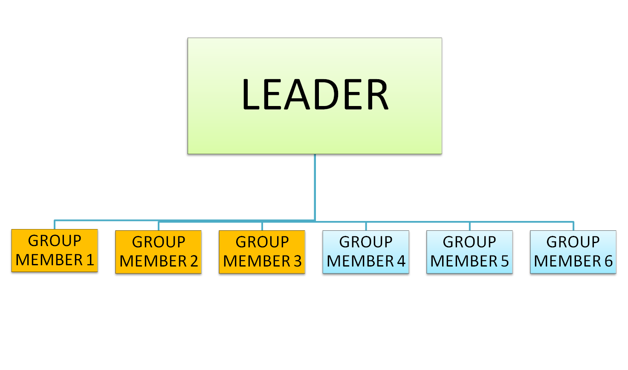





Slide 24
A. DIFFERENT- QUALITY RELATIONSHIP
Graen argue that leaders do not typically use the same leadership style in dealing with the group members.
They treat each member differently as it comes.
The relationships that exist between the leader and each member probably differs in quality.
In theory, the differences lie on a continuum of low quality to high quality.

Slide 25
With group members on top half of the continuum, the leader has a good relationship;
With those on lower half of the continuum, the leader has a poor relationship.
Each of these pairs of relationships, or dyads must be judged in terms of whether a group member is “in” or “out”.

Slide 26
IN GROUP AND OUT GROUP
IN GROUP
OUT GROUP
Are invited to participate in important decision making.
Are given added responsibility and are privy to interesting gossip.
Member is elevated to the unofficial role of trusted assistant.
Achieve higher level of performance, commitment and satisfaction.
Less likely to quit the job.
Are managed according to the requirements of their employment contract.
They receive little warmth, inspiration or encouragement.
Member is treated much like a hired hand.
Quits job easily.

Slide 27
B. FIRST IMPRESSION
The Leader’s first impression of a group member’s competency plays important role in placing member in the “in group” or “out group”.
Field study seems to confirm that first impressions make a difference.
Researchers gathered some aspects of the manager- group member dyad.
One measure was the group members’ perceived similarity with the leader.
GROUP MEMBERS FOR LEADER:
1. “My supervisor and I are alike in number of ways.”
2. “I like my supervisor very much as a friend.”
3. “I like my supervisor as a great guide.”

Slide 28
LEADER ABOUT MEMBERS
“I think my new employees will be excellent.”
“I like my subordinate very much as a friend.”
“I think my new employees are laborious.”

Slide 29
LEADER’S ROLE IN THE TEAM BASED ORGANIZATION
Building trust and inspiring teamwork.
Coaching team members and group members toward higher of performance.
Facilitating and supporting the team’s decisions.
Expanding the team’s capability.
Creating a team identity
Anticipating and influencing change.
Inspiring the team towards higher levels of performance.
Enabling and empowering group members to accomplish their work.
Encouraging team members to eliminate low value work.

